Slide 1
Set Apart For His Glory :
Holiness In Action
UNITY :–
THE PRIME DIRECTIVE
EPHESIANS
4 v 1 to 16

Slide 2
UNITY – THE PRIME DIRECTIVE
EPHESIANS 4 v 1 to 16
Unity and Maturity in the Body of Christ
As a prisoner for the Lord, then, I urge you to live a life worthy of the calling you have received. ² Be completely humble and gentle; be patient, bearing with one another in love. ³ Make every effort to keep the unity of the Spirit through the bond of peace. ⁴ There is one body and one Spirit, just as you were called to one hope when you were called; ⁵ one Lord, one faith, one baptism; ⁶ one God and Father of all, who is over all and through all and in all.

Slide 3
⁷ But to each one of us grace has been given as Christ apportioned it. ⁸ This is why it says:
“When he ascended on high, he took many captives and gave gifts to his people.”
⁹ (What does “he ascended” mean except that he also descended to the lower, earthly regions? ¹⁰ He who descended is the very one who ascended higher than all the heavens, in order to fill the whole universe.) ¹¹ So Christ himself gave the apostles, the prophets, the evangelists, the pastors and teachers, ¹² to equip his people for works of service, so that the body of Christ may be built up ¹³ until we all reach unity in the faith and in the knowledge of the Son of God and become mature, attaining to the whole measure of the fullness of Christ.

Slide 4
¹⁴ Then we will no longer be infants, tossed back and forth by the waves, and blown here and there by every wind of teaching and by the cunning and craftiness of people in their deceitful scheming. ¹⁵ Instead, speaking the truth in love, we will grow to become in every respect the mature body of him who is the head, that is, Christ. ¹⁶ From him the whole body, joined and held together by every supporting ligament, grows and builds itself up in love, as each part does its work.

Slide 5


Slide 6
ATHOS – He was always calm and a thinker. Very good at judgement and planning.
PORTHOS – he was the loudest and physically the strongest, and more than often relied on sheer power and bravery in combat.
ARAMIS – He was the most intelligent of all of them. Highly educated and skilled in strategy, tactics and plans. An excellent swordsman who was cunning and understood diplomacy.

Slide 7


Slide 8
ALL FOR ONE AND ONE FOR ALL
”It signifies an approach where a group acts for the
benefit of the whole,
and the whole acts for the benefit of each individual”.

Slide 9


FEDERAL PALACE
OF SWITZERLAND
AN ATTITUDE
FOR OUR LIVES

Slide 10
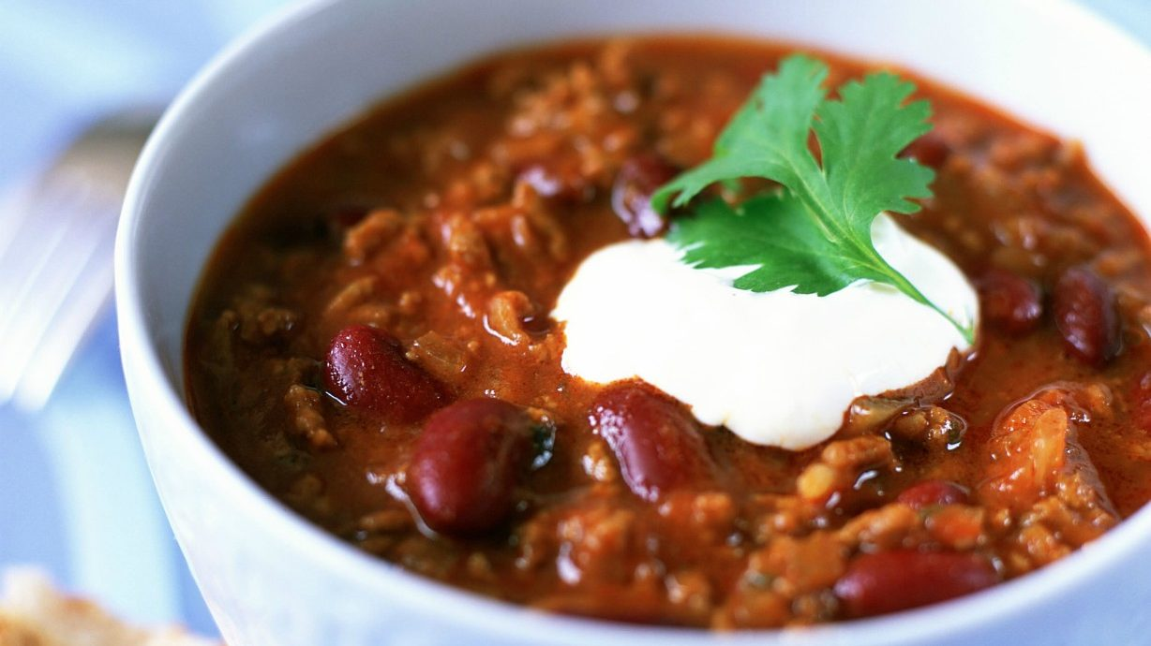

Slide 11


Slide 12


Verses 1 – 3
As a prisoner for the Lord, then, I urge you to live a life worthy of the calling you have received. Be completely humble and gentle; be patient, bearing with one another in love. Make every effort to keep the unity of the Spirit through the bond of peace.
Walk worthily of your calling by maintaining the unity of the Spirit by love.

Slide 13
Verses 4 – 6
There is one body and one Spirit, just as you were called to one hope when you were called; one Lord, one faith, one baptism; one God and Father of all, who is over all and through all and in all.
There is an objective ground for this unity in the oneness of God and faith. This is God’s heart and planned purpose for us

Slide 14

Verses 7 – 10
But to each one of us grace has been given as Christ apportioned it. This is why it says:
“When he ascended on high, he took many captives and gave gifts to his people.”
9 (What does “he ascended” mean except that he also descended to the lower, earthly regions? 10 He who descended is the very one
who ascended higher than all the heavens, in order to fill the whole universe.)
The risen Christ has given gifts to all Christians as a way of maintaining the unity we already have and attaining even stronger unity by love in the future.

Slide 15
Verses 11 – 12
It was he who gave some to be apostles, some to be prophets, some to be evangelists, some to be pastors and teachers, to prepare God’s people for works of service, so that the body of Christ may be built up.
In a more detailed explanation of this way of unity by love, he also gave foundational and ongoing leaders to the Church, with a focus on teaching to equip all Christians to minister to each other in truth and love.

Slide 16
Verses 13 - 16
Until we all reach unity in the faith and in the knowledge of the Son of God and become mature, attaining to the whole measure of the fullness of Christ. Then we will no longer be infants, tossed back and forth by the waves, and blown here and there by every wind of teaching and by the cunning and craftiness of men in their deceitful scheming. Instead, speaking the truth in love, we will in all things grow up into him who is the Head, that is Christ. From him the whole body, joined and held together by every supporting ligament, grows and builds itself up in love, as each part does its work.
The aim of Christ giving gifts is that every member of the body of Christ would by love and truth, stops being an unstable child and becomes a unified representation of Christ.

Slide 17
Maintain (v3) and attain (v13) unity by love (v2, 15, 16) by ministering to each other (v12) with the gifts of Christ (v7) centrally speaking to each other the truth about Christ (v15) as you are equipped by Christ given shepherds and teachers (v11, 12)
Verses 1 - 16
The ultimate boil down !!!

Slide 18


When we pursue unity, the God of love and peace dwells within us.
2 Corinthians 13:11
When we live in unity with each other, we glorify God together.
Romans 15: 5 - 6
When we are unified, the world we see Christ in us.
John 17: 20 - 21

